Slide 1

SHRI VAISHNAV VIDYAPEETH VISHWAVIDYALAYA, INDORE
APPLICATION LAYER
Branch: IT-B
Subject: Computer Network
[BTIT502]
Presented By: Shristi Sisodiya
[19100BTIT06615]

Slide 2
Contents
Introduction
Protocols of Application Layer
HTTP
FTP
SSH
Services
Summary

Slide 3
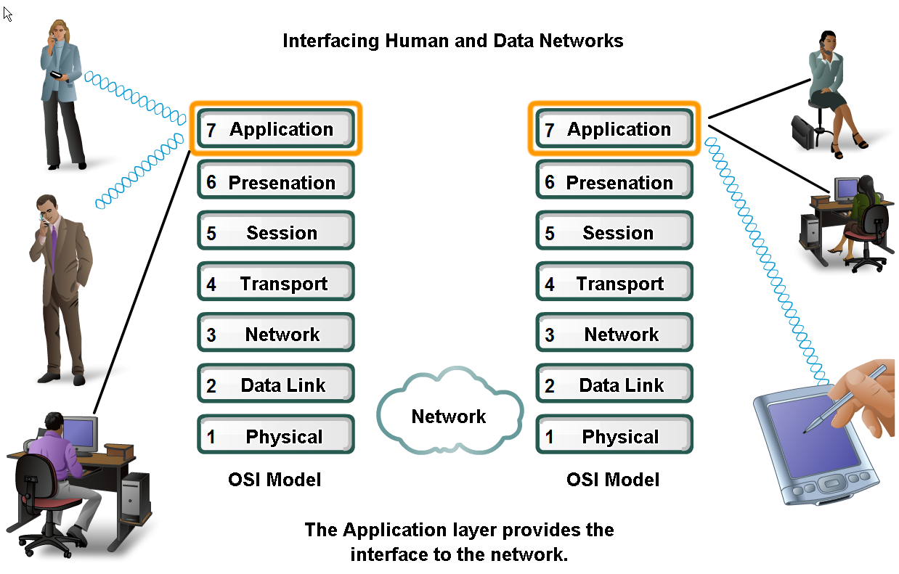
Introduction
Application Layer The application layer is closest to the end user.
Network applications enable users to send and receive data with ease.
The application layer acts as interface between the applications and the underlying network.

Slide 4
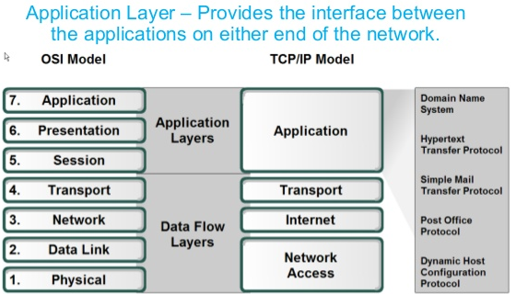
Introduction
Application Layer Protocols help exchange data between programs running on the source and destination hosts.
The TCP/IP application layer performs the functions of the upper three layers of the OSI model.
Common application layer protocols include: HTTP, FTP, SSH.

Slide 5
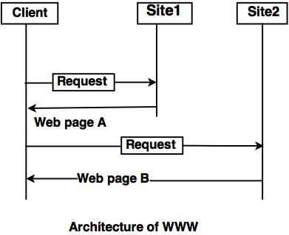
WWW (World Wide Web)
The World Wide Web (WWW) is a collection of documents and other web resources which are identified by URLs, interlinked by hypertext links, and can be accessed and searched by browsers via the Internet.
World Wide Web is also called the Web and it was invented by Tim Berners-Lee in 1989.
Website is a collection of web pages belonging to a particular organization. The pages can be retrieved and viewed by using browser.
HERE in the Figure
The client wants to see some
information that belongs to site 1.
It sends a request through its
browser to the server at site 2.
The server at site 1 finds
the document and sends it to the client.

Slide 6
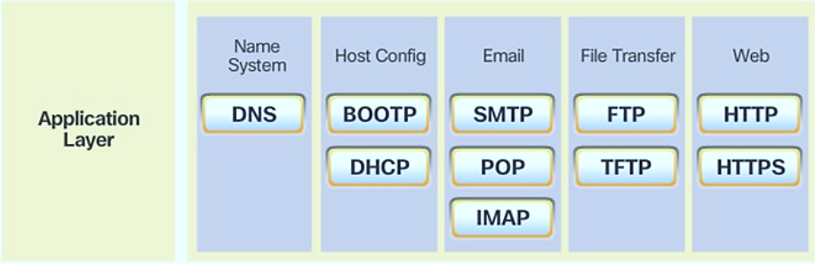
TCP/IP Application Layer Protocols
TCP/IP application protocols specify the format and control information necessary for common Internet functions.
Application layer protocols must be implemented in both the source and destination devices.

Slide 7
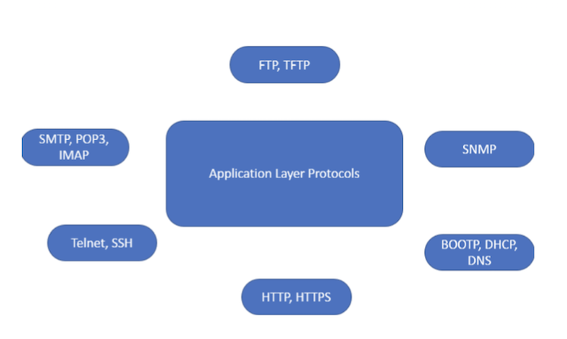
TCP/IP Application Layer Protocols
Application layer protocols implemented on the source and destination host must be compatible to allow communication.
Most TCP/IP protocols defined in RFCs (Request For Comments) of the IETF (Internet Engineering Task Force)

Slide 8
HTTP (Hypertext Transfer Protocol)
This is a protocol used mainly to access data on the World Wide Web (www).
The Hypertext Transfer Protocol (HTTP) the Web's main application-layer protocol although current browsers can access other types of servers
A repository of information spread all over the world and linked together. The HTIP protocol transfer data in the form of plain text, hyper text, audio, video and so on.
HTTP utilizes TCP connections to send client requests and server replies. It is a synchronous protocol which works by making both persistent and non persistent connections.
Three common message types: -
GET: request pages from web server
POST: includes data in the message sent to server
PUT: upload resources and content to the web server

Slide 9
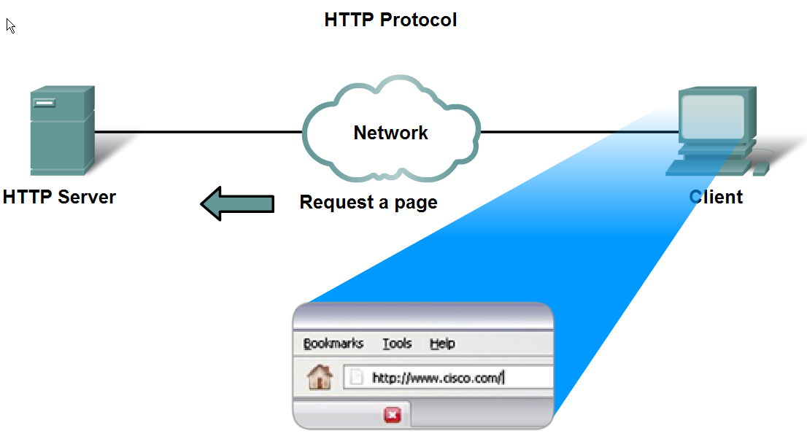
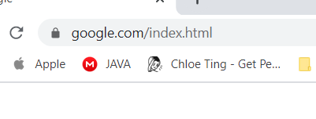
HTTP (Hypertext Transfer Protocol)
HTTP: Hypertext Transfer Protocol (defined in RFC2616)
Web browser application:
Check 3 parts of address (i.e. http://www.google.com/index.html)
Check server name to convert kis.p.lodz.pl into numeric address
Send GET request to the server and asks for the file index.html
Deciphers the HTML code sent by the server and formats the page
http://www.kis.p.lodz.pl

Slide 10
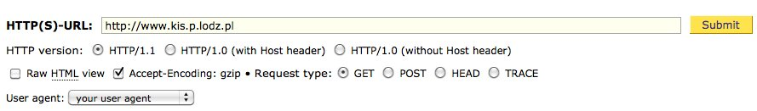
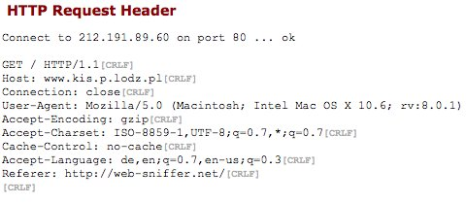
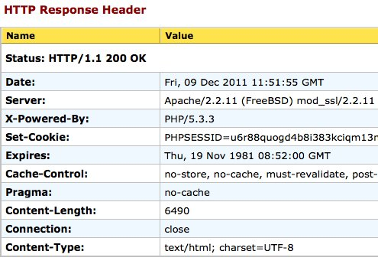
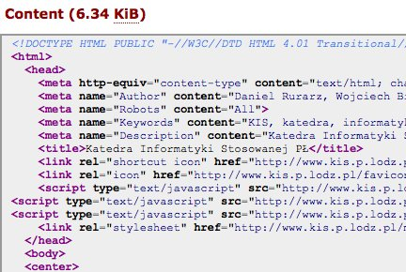
HTTP (Hypertext Transfer Protocol)
By using “web-sniffer.net” to view http request/response and html source code.
http://www.google.com

Slide 11
FTP (File Transfer Protocol)
FTP was developed to allow the transfer of files over the network.
An FTP client is an application that runs on a client computer used to push and pull data from an FTP server.
FTP requires two connections between the client and the server: one connection for commands and replies and another connection for the actual file transfer.
The client initiates and establishes the first connection to the server for control traffic on TCP port 21.
The client then establishes the second connection to the server for the actual data transfer on TCP port 20.
The client can download (pull) data from the server or upload (push) data to the server.

Slide 12
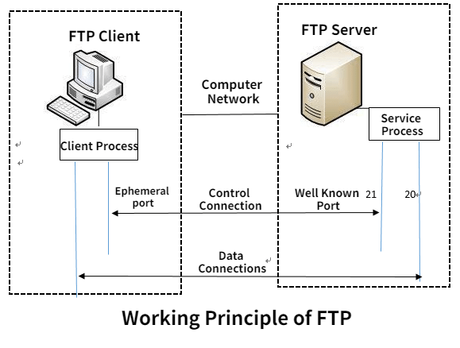
FTP (File Transfer Protocol)
File Transfer Protocol (defined in RFC959)
A 2-connection step for file transfer between client and server
1st connection (port 21): control traffic (client command and server replies)
2nd connection (port 20): data traffic (created every time a file is transferred)
Download/upload
Secure FTP: FTPS / SFTP (SSH)

Slide 13
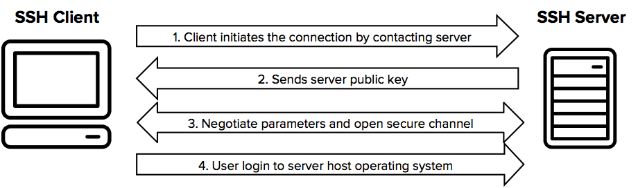
SSH Protocol (Secure Shell)
The SSH protocol (also referred to as Secure Shell) is a method for secure remote login from one computer to another.
It provides several alternative options for strong authentication, and it protects the communications security and integrity with strong encryption.
It is a secure alternative to the non-protected login protocols (such as telnet, rlogin) and insecure file transfer methods (such as FTP).
SSH provides a secure channel for data transmission and provides a secure pipe to open up a command interpreter.

Slide 14
Services of Application Layers
Network Virtual terminal: An application layer allows a user to log on to a remote host. To do so, the application creates a software emulation of a terminal at the remote host. The user's computer talks to the software terminal, which in turn, talks to the host. The remote host thinks that it is communicating with one of its own terminals, so it allows the user to log on.
File Transfer, Access, and Management (FTAM): An application allows a user to access files in a remote computer, to retrieve files from a computer and to manage files in a remote computer. FTAM defines a hierarchical virtual file in terms of file structure, file attributes and the kind of operations performed on the files and their attributes.

Slide 15
Services of Application Layers
Addressing: To obtain communication between client and server, there is a need for addressing. When a client made a request to the server, the request contains the server address and its own address. The server response to the client request, the request contains the destination address, i.e., client address. To achieve this kind of addressing, DNS is used.
Mail Services: An application layer provides Email forwarding and storage.
Directory Services: An application contains a distributed database that provides access for global information about various objects and services.
Authentication: It authenticates the sender or receiver's message or both.

Slide 16
Summary
The application layer is the topmost layer of the protocol hierarchy. It is the layer where actual communication is initiated.
It uses the services of the transport layer, the network layer, the data link layer, and the physical layer to transfer data to a remote host.
In it we have discussed some of the application layer protocols.
We have seen the services in this layer.
Overview of the Application layer
FTP
HTTP
WWW
SSH

Slide 17
REFERENCES
www.google.co
www.wikipedia.org
www.google.co.in.imghp
www.books.google.co.in

Slide 18

THANK YOU

